Slide 1


WHAT ARE THE FACTORS THAT INFLUENCE CUSTOMER SPENDING BEHAVIOUR?
2
+
2
+
Emmanuel Chakkalakkal
Likitha Shivananjegowda
Seliz Suresh Koshy

Slide 2
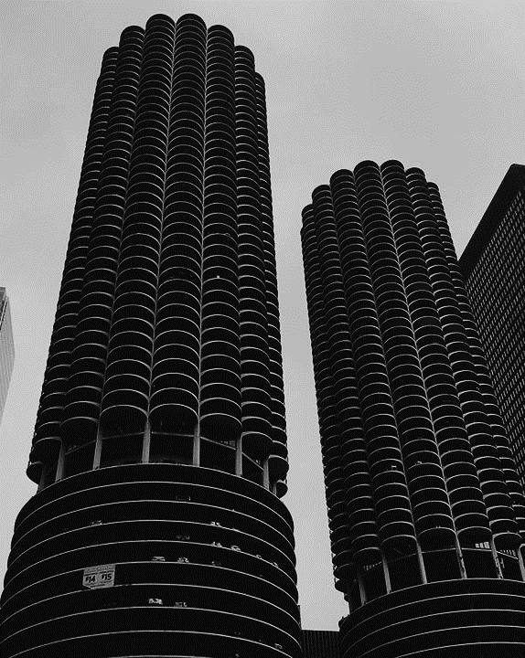
WHY THE TOPIC?
2
+
It is an essential aspect to understand how and why customers spend money in order to maximize profits and building a successful brand
Factors like age, gender, income, and education level can impact how much customers are willing to spend.
To gain insights into what motivates customers to spend money and how to better tailor their products and marketing messages to meet those needs.

Slide 3

DATASET
2
+
We have decided to use our dataset from Kaggle that consists of Swiggy data will help them to analyze the restaurant's data from all over India based on different factors like cuisine, cost, states, regions, reviews, ratings, etc.
Link : Swiggy dataset
Records : Around 142k records
Gitlab repository : Group_19_gitlab_repo

Slide 4

Features
Features | About | DType
city | The city where the restaurant is located | object
rating | Rating of the Restaurant | int64
rating_count | Number of People given the Rating | object
cost | Cost of eating in that restaurant | object
cuisine | Cuisines that restaurant serves | object
no_years_open | Derived from the lic_no column | int64
weekly_avg_salary | Derived the weekly avg salary for each state by combining a dataset from moneymint which contain avg salary by month for each state. | int64

Slide 5
Related Work
Paper uses XGBoost, LightGBM, and combined models of the latter two for predicting user behavior.
Used a combination of LSTM and RF on a consumer product time series data.
How different menu price formats affect restaurant consumer behavior. The study found that how prices are presented on a menu can influence customers' perception of value and affect their willingness to spend money.
Focuses on developing a method to identify sentences in consumer product reviews that express how the product is used.
Explores the increasingly driven by convenience, i.e, traditional brick-and-mortar stores vs shopping online/hybrid models on which has a better effect in being successful.

Slide 6
Proposed Method
Data Collection : Selecting the relevant data that matches our research question
Data Cleaning : Analyzed the dataset for class imbalance and checked the percentage of missing values.
Dropped rows of columns having minute null values and imputed rows with mode values for those having higher % of null values. We found that only 0.1% of the data was lost during cleaning.
Replaced 0.0 values in rating column with the mean values to handle missing values.
Perform typecasting on cost column from string to float and removing the '₹' symbol.
Modelling : Models used XGBoost Regressor, Random Forest Regressor, and Decision Tree Regressor.
(X) Input variables - ’cuisine', 'city’, ’rating_count ’ ,’cost’, ’no_years_open’, ‘weekly_avg_salary’
(y) Target variable - ‘ratings’

Slide 7
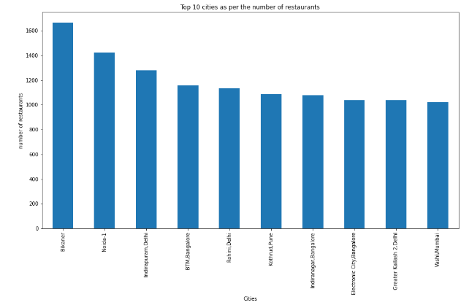
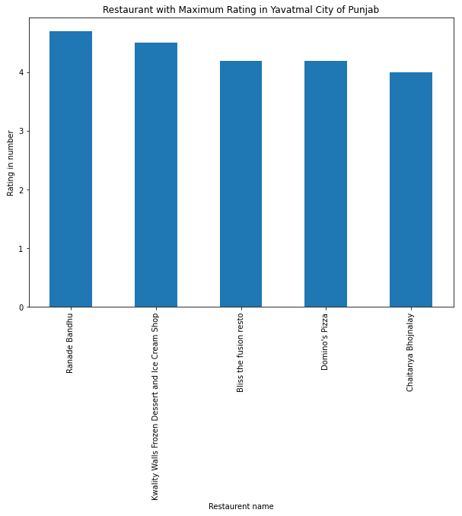
Visualisation
Top 10 cities as per the number of restaurants listed
Top 5 most popular restaurant chains in India

Slide 8
Observations
We evaluated our model on 148242 records obtained after preprocessing from the original dataset.
The MAE(Mean Absolute Error),RMSE(Root Mean Square) and R-squared is used to evaluate our models.
Below table shows the results -
Models | Mean Absolute Error | Root Mean Square | R-squared
Random Forest Regressor | 1.103 | 1.154 | 0.015
XGBoost Regressor | 0.783 | 1.186 | -0.039
Decision Tree Regressor | 0.212 | 0.425 | 0.866

Slide 9
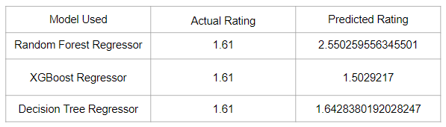
Results
From our investigation we found that Decision Tree Regressor seem to perform better in terms of the score compared to the other models.
The predicted rating is depicted in the below table with Decision Tree Regressor having closer value to the actual rating.
Future Work : As part of future work this time series data can be used on the combined LSTM-rf model to possibly provide more accurate scoring.

Slide 10

THANK YOU
2
+
2
+

